Slide 1


Good Morning
Dr. Nikhil Moutam
3rd Year PG Student
Dept of Public Health Dentistry

Slide 2
LESSON PLAN
Title | Concept of Health and disease
Audience | III BDS students
Audio-visual aids | PROJECTOR , POWER POINT PRESENTATION, POINTER
Duration | 40 minutes

Slide 3
Introduction
“Health “ in history
Why we are concerned about ‘health’
Health - Changing concepts
  Biomedical
  Ecological
  Psychological
  Holistic

Slide 4
What is ‘Health’
Oxford dictionary
  State of being well in body or mind
Webster
  The condition of being sound in body, mind or spirit especially freedom from physical disease or pain.
“Health is a state of complete physical, mental and social well-being and not merely the absence of disease or Infirmity.”
– Constitution of the World Health Organization,
July 1946.

Slide 5
Physical component…
-The state of perfect functioning of body or state in which every cell & every organ is functioning at optimum capacity & in perfect harmony with the rest of the body.

Slide 6
Mental component-
Mental Health- Is a state of balance between individual and surrounding..
Easy to say if its grossly abnormal but difficult in minor disturbances.
Distinction between mental and physical health is artificial.

Slide 7
Social component
Social health is an aspect of health that includes social relationships as part of broader concept of health.
It has two elements:
Individual and societal
The less isolated, the greater the sense of control & empowerment, & the more socially integrated a person is, the less they suffer from a range of physical & mental disorders.

Slide 8
Positive Health
Positive health describes a state beyond the mere absence of disease.
Operationalised by a combination of excellent status on biological, subjective, and functional measures
Positive health predicts increased longevity (correcting for quality of life), decreased health costs, better mental health in aging, and better prognosis when illness strikes.

Slide 9
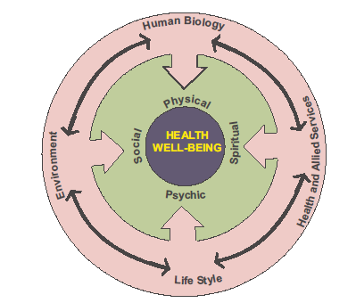
Health Paradigm

Slide 10
Changing concepts of Health
Biomedical Concept- “absence of disease”
human body = machine,
disease = consequence of the break down
Doctor’s task = repair of machine.
Limitation- it has minimized the role of environmental, social, psychological & cultural determinants of health.

Slide 11
Changing concepts of Health
Ecological Concept-
  Health = is a dynamic equilibrium between man & his environment,
  Disease = maladjustment of the human organisms to the environment.
The concept supports the need for clean air, safe water, ozonic layer in the atmosphere, etc. to protect us from exposure to unhealthy factors.

Slide 12
Changing concepts of Health
Psychosocial Concept
Health is not only a biomedical phenomenon, but one which is in influenced by social psychological, cultural, economic and political factors of the people concerned.

Slide 13
Changing concepts of Health
Holistic Concept –
biomedical + ecological + psychosocial concept.
It has been defined as unified or multidimensional process involving the well being of the whole person in the context of his environment.
Holistic concept implies that, all sectors of society have an effect on health

Slide 14
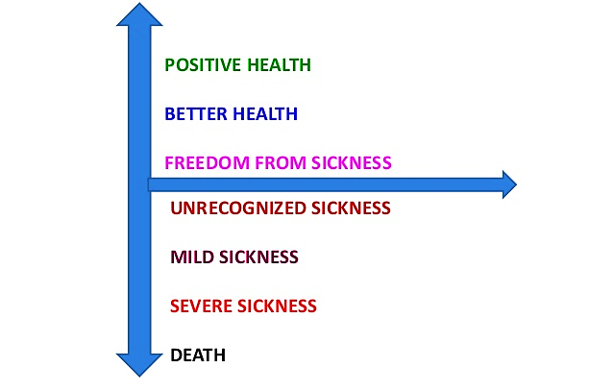

Slide 15
Concept of Disease

Slide 16
Concept of Disease
“A condition in which body function is impaired, departure from a state of health, an alteration of the human body interrupting the performance of the vital functions.” - Webster.
Oxford English Dictionary – the condition of body or some part of organ of body in which its functions are disrupted or deranged.
Ecologically – ‘a maladjustment of human organism to the environment’
Simplest definition – ‘opposite to Health’.

Slide 17
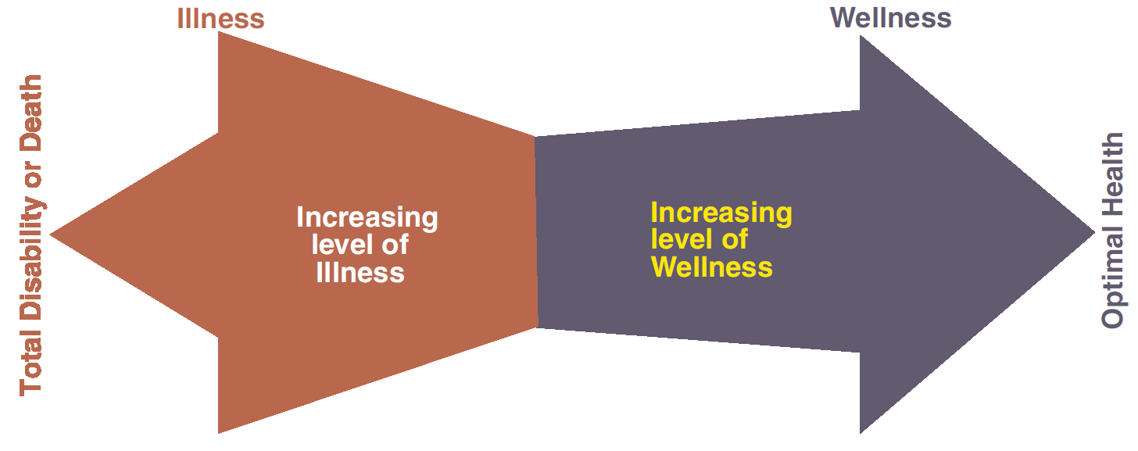
HEALTH AND ILLNESS

Slide 18
Epidemiological triad
Agent Factors
  Physical Agents
  Chemical Agents
  Biological Agents
  Nutritional agents
Environmental Factors
  Physical Environment
  Biological Environment
  Social Environment
Host Factors
  Socio-demographic Factors
  Psycho-social Factors
  Intrinsic Characteristics

Slide 19
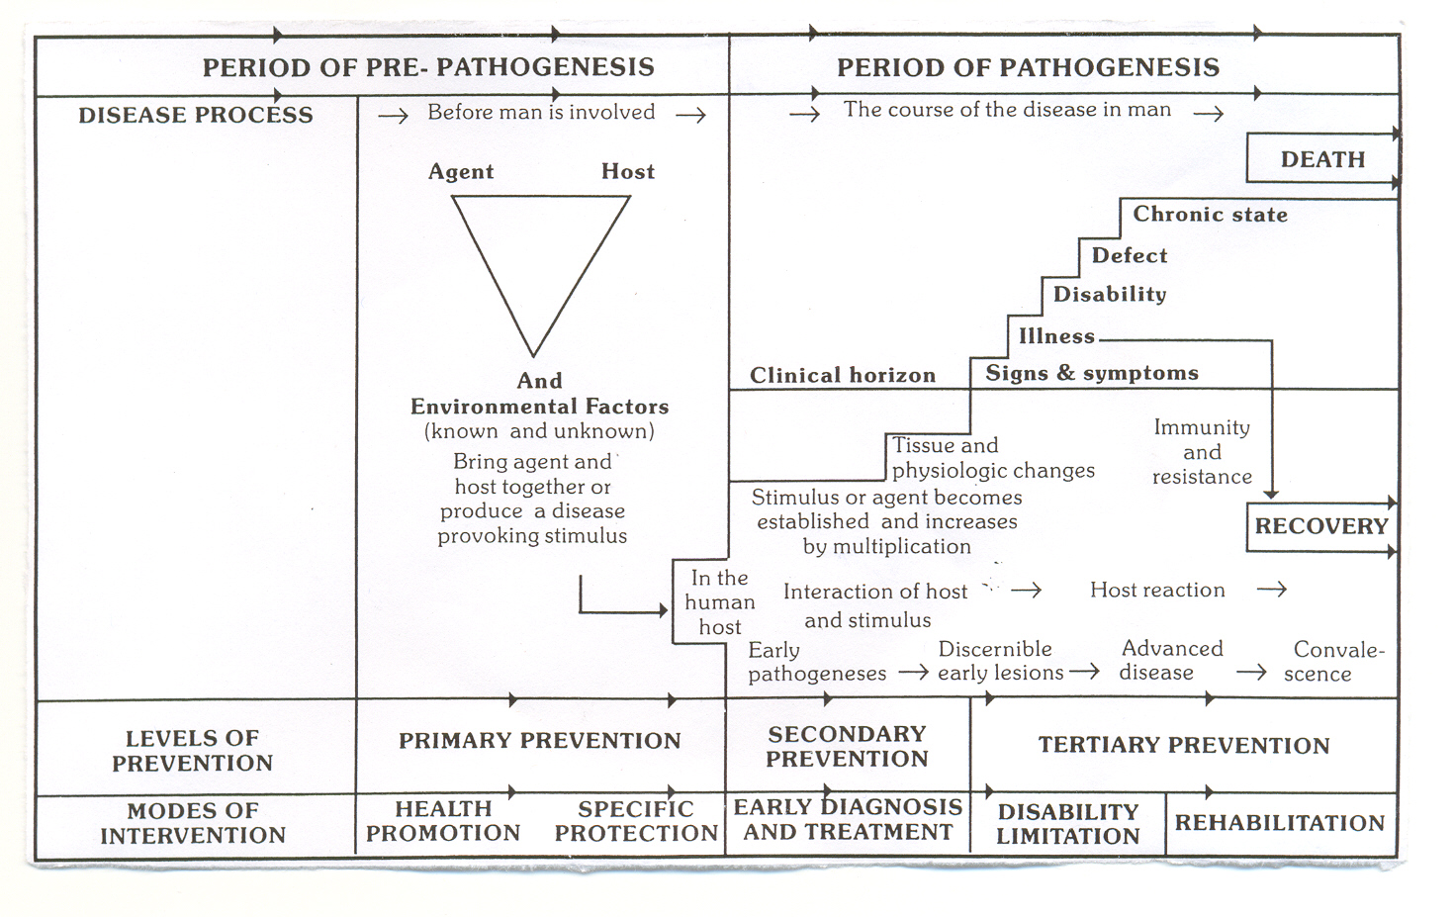
Natural History of Disease
Notes:
Period of prepathogenesis
Period of pathogenesis

Slide 20
Web of causation
Change in life style Stress
Abundance of food Smoking Emotional Aging & D Disturbance other factor
Obesity Lack of physical activity Hypertension
Hyperlidemia Increase catacholamine Changes in walls of arteries
thrombotic activity
Coronory atherosclerosis
Coronary occlusion
Myocardial Infarction
Myocardial Infarction

Slide 21
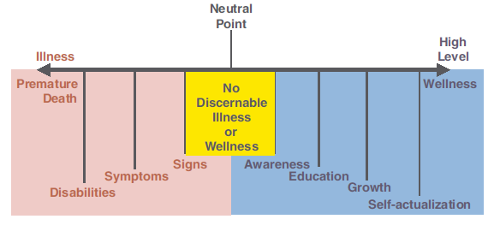
The Health-Sickness spectrum

Slide 22
Disease in many Forms..
Spectrum of disease
Acute
Chronic/insidious
Carrier

Slide 23
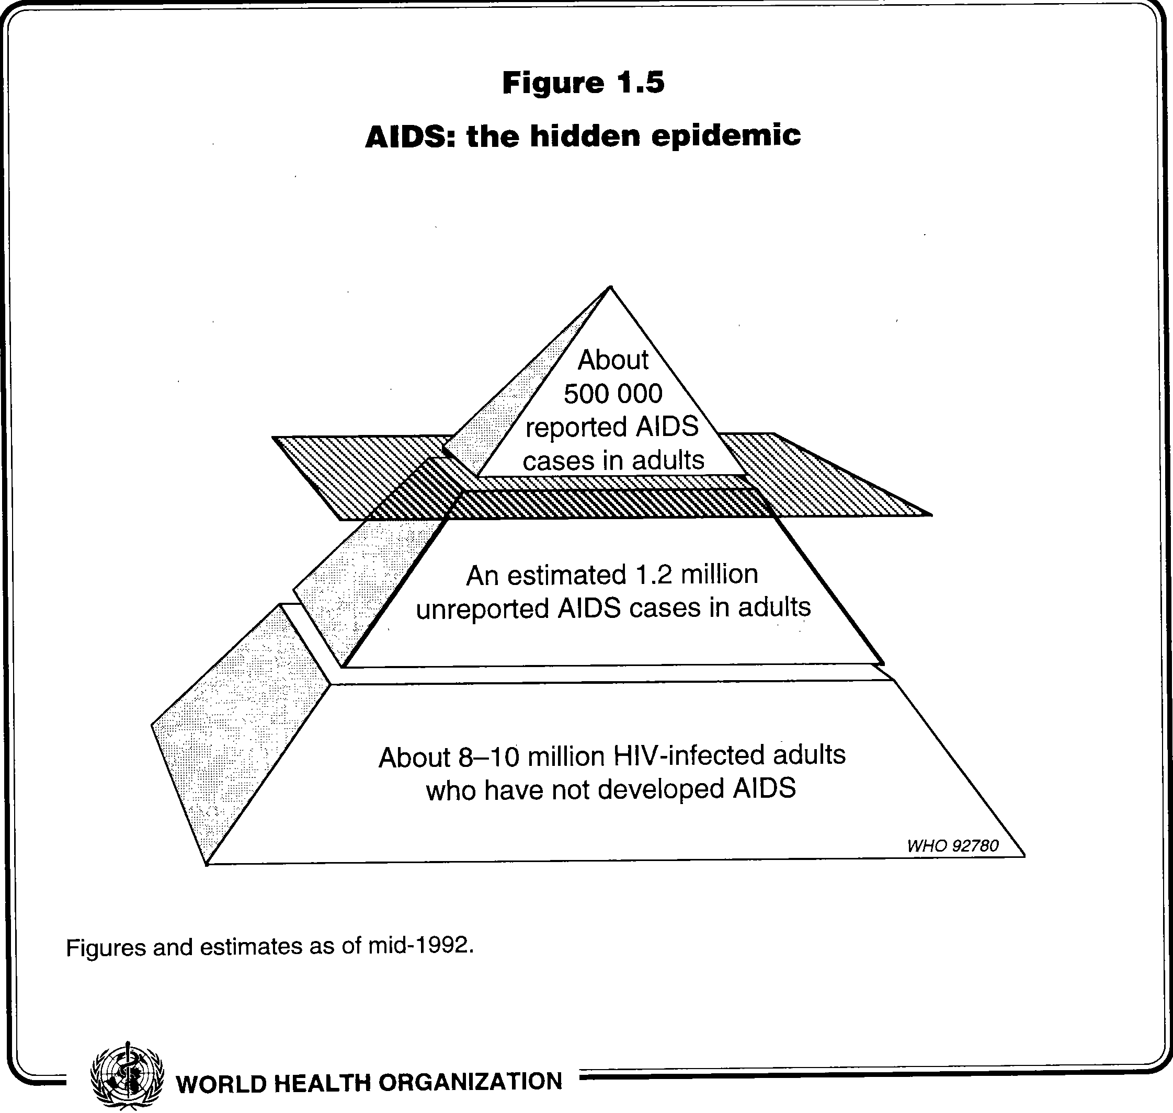
ICEBERG PHENONMENON
Example: Cholera , Polio, hypertension, malnutrition etc.

Slide 24
Thank you.

